Slide 1
CREDIT CARD FRAUD DETECTION

Slide 2
ABSTRACT
In day to day life credit cards are used for purchasing goods and services with the help of virtual card for online transaction or physical card for offline transaction.
In a physical-card based purchase, the cardholder presents his card physically to a merchant for making a payment. To carry out fraudulent transactions in this kind of purchase; an attacker has to steal the credit card.
. In online payment mode, attackers need only little information for doing fraudulent transaction (secure code, card number, expiration date etc.)
In this purchase method, mainly transactions will be done through Internet or telephone. To commit fraud in these types of purchases, a fraudster simply needs to know the card details. Most of the time, the genuine cardholder is not aware that someone else has seen or stolen his card information. The only way to detect this kind of fraud is to analyze the spending patterns on every card and to figure out any inconsistency with respect to the “usual” spending patterns.

Slide 3
MOTIVATION
In order to identify the credit card fraudulent transactions, in this project we propose an optimized SVM model for detection of fraudulent online credit card model.

Slide 4
PROBLEM STATEMENT
Payments using credit cards have increased in recent years. It may be used in online or in regular shopping. Now-a-days credit card payments are necessary and convenient to use. Due to the increase of fraudulent transactions, there is a need to find the efficient fraud detection model.

Slide 5
EXISTING SYSTEM
Financial market makes the credit card business become one of the bank’s most important incomes. But along with the growth of issuance volume, global credit fraud transactions increase at an alarming rate. Financial companies cannot effectively discover fraudulent transactions.

Slide 6
PROPOSED SYSTEM
To Study and analyze various Credit Card Fraud Detection techniques
To Propose a new Credit Card Fraud Detection based on Data Mining using Support Vector Machines
To employ the incremental learning technique to reduce the misclassification rate and generation of false alarms
To Evaluate the proposed technique using various input and output parameters such as Classification errors, Accuracy and False Alarms.

Slide 7
Working procedure
Dataset collection and loading:
Using this module we will collect dataset from kaggle website which has features and labels denoted as v1 to v60 as features and 1,0 as labels. This data set is in csv format this is loaded
Preprocessing:
In this module dataset is organized in required manner and data set features and labels are stored in two variables.
Data set Testing and Training:
Uisng sklearn library using train and test function data set is divided in to train, test where train will have x, y values features and labels of all records in dataset where as in test only half of records will be there.

Slide 8
Analysis and Prediction accuracy checking:
In this module test and train data is analyzed and data is shown in the form of graphs and svm algorithm is used to predict results using test data with train data.

Slide 9
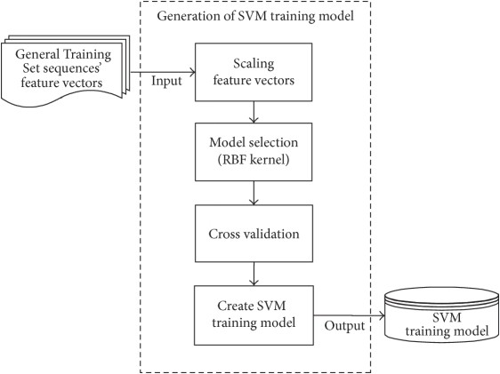
ARCHITECTURE DIAGRAM

Slide 10
SOFTWARE REQUIREMENT
Operating system : Windows XP/7/10
Coding Language : python
Tool : Jupiter
IDE : Anaconda prompt
Framework : Flask

Slide 11
HARDWARE REQUIREMENT
System : Pentium IV 2.4 GHz.
Hard Disk : 100 GB.
Monitor : 15 VGA Color.
Mouse : Logitech.
RAM : 1 GB.

Slide 12
REFERENCES
Ming Xiao, The anti-fraud reserch for credit card online payment, Nankai University, May 2010.
Pai, Ping-Feng, Chih-Shen Lin, A hybrid ARIMA and support vector machines model in stock price forecasting, Omega: International Journal of Management Science, 2005, 33(6): 497-505.
Linhui Li, Intrusion Detection Based on Feature Selection, Zhongnan forestry university of science and technology, 2009.
Ling Yang, Tongue color pattern recognition system, Nankai University, 2008.
C. Chiu, C. Tsai: A Web Services-Based Collaborative Scheme for Credit Card Fraud Detection[C].Proceedings of 2004 IEEE International Conference on e-Technology, e-Commerce and e-Service,2004:177-181.
Daqin Wei, Detection of risk of credit card transactions based on data mining, Chengdu: Sichuan Normal University, 2007.
Delamaire,L., Abdou,H., and Pointon,J.,(2009) "Credit card fraud and detection techniques: a review." Banks and Bank systems ,4(2),pp. 57-68.

